Slide 1

Helm and the power of automation in Kubernetes
Debobrata Pal
Cloud Lead @ GDSC SurTech
Tech Team Co-Lead @ CNH Hooghly
dev.debobratapal@gmail.com

Slide 2
Agenda
Deploying app on a running Kubernetes cluster
kubectl way
Helm way
Helm in action
Learn more about Helm
How it works?
Charts
Repository
Release
Installation
Summary
Kubernetes vs Helm

Slide 3
Deploying an app - kubectl way
Create a yaml manifest to deploy on kubernetes (Ex:- deployment.yaml)
Use kubectl command to deploy our yaml manifests. (Ex:- kubectl apply -f deployment.yaml)
Check the newly created resources (Ex:- kubectl get deployment -A)
kubectl:- a command-line tool that allows users to communicate with the Kubernetes API and the control plane.

Slide 4
Deploying an app - kubectl way
Pain points
CI/CD pipeline
kubectl deployments are not easy to configure, update and rollback
Deploying app to dev/test/production may require different configuration
Update deployment e.g. update with a new image
Change the configuration based on certain conditions
A different serviceType is needed in different environments (e.g. NodePort/LoadBalancer)
Need for rollback
Need of having multiple deployments (e.g. multiple Redis deployments)
Requires to track your deployment and modify YAML files (can be error prone)
Does not allow multiple deployments without updating metadata in manifest files
Share your deployment configurations with your friend, team or customer?
You need to share many files and related dependencies
Your users are required to have knowledge of deployment configuration

Slide 5
Deploying an app - Helm Way
No expertise of Kubernetes deployment needed as Helm hides Kubernetes domain complexities
Helm packages all dependencies
Desired configuration can be passed at runtime as key-value
Helm tracks deployment making it easy to update and rollback
Same workload can be deployed multiple times
Helm allows assigning workload release names at runtime
Easy to share

Slide 6
What is Helm?
Helm is a tool that streamlines installation and management of Kubernetes applications
Helm became a CNCF project in mid 2018
It uses a packaging format called charts
A chart is a collection of files that describe Kubernetes resources
Think of Helm like apt/yum/homebrew for Kubernetes
Helm is available for various operating systems like OSX, Linux and Windows
Run Helm anywhere e.g. laptop, CI/CD etc.

Slide 7
4 Mantras to master Helm
helm
While Helm is the name of the project, the command line client is also named helm. By convention, when speaking of the project, Helm is capitalized. When speaking of the client, helm is in lowercase.
Chart
It contains all of the resource definitions necessary to run an application, tool, or service inside of a Kubernetes cluster. A chart is basically a package of pre-configured Kubernetes resources.
Release
An instance of a chart running in a Kubernetes cluster
Same chart can be deployed multiple time
Repository
Place where charts reside and can be shared with others

Slide 8
Helm in action
Check existing installation of Helm chart
helm ls
Check what repo do you have
helm repo list
Add repo
helm repo add ingress-nginx https://kubernetes.github.io/ingress-nginx
Verify that ingress-nginx/ingress-nginx is now in your repo
helm repo list
helm search ingress-nginx
Install
helm install my-ingress-nginx ingress-nginx/ingress-nginx --version 4.10.0 –namespace ingress-nginx —-create-namespace
Verify that your ingress-nginx chart is installed
helm ls
Check chart release history
helm history my-ingress-nginx

Slide 9
Clean Up
Remove repo
helm repo remove ingress-nginx
Remove chart completely
helm delete --purge my-ingress-nginx
Delete all Kubernetes resources generated when the chart was instantiated

Slide 10
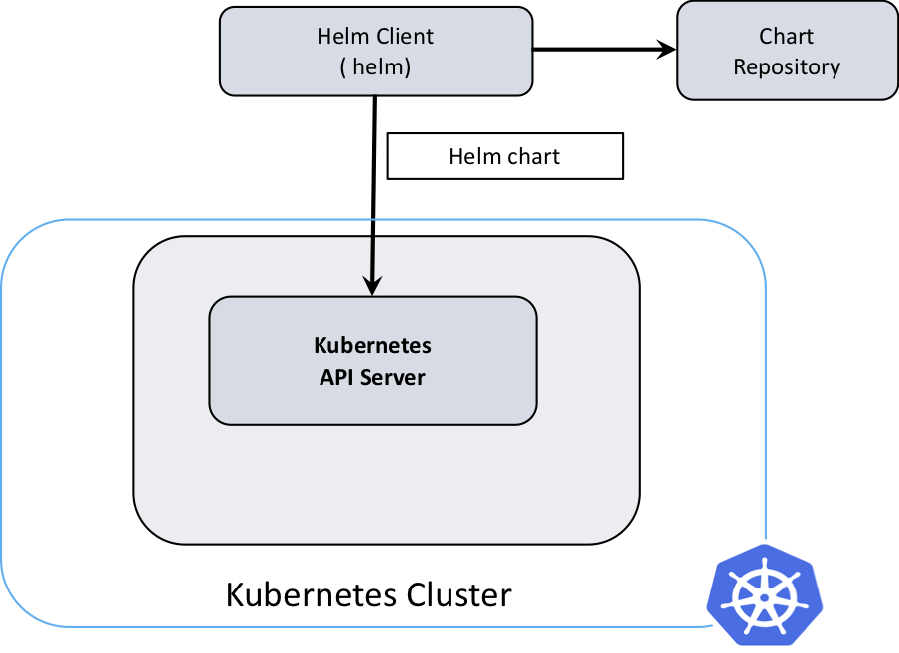
Architecture of Helm
The Helm Client (helm)
Command-line client for end users
Interacts with the Kubernetes API server sending charts to be installed/upgrade/uninstall
Interacts with the chart repository
Renders templates to Kubernetes manifest files

Slide 11
Charts are all about…
A collection of files that describe a related set of Kubernetes resources
Files laid out in a directory tree structure
Templates based on "Go template language" + functions from “Sprig” lib + specialized functions:
values, functions, pipelines, operators, flow control, variables, built-in objects
Templates rendered by Helm template engine into Kubernetes manifest files
Can be packaged into versioned objects for sharing (repos)
Charts can have dependencies on other charts

Slide 12
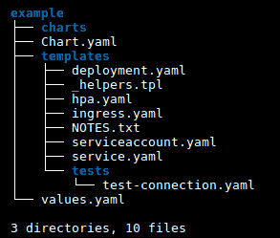
Chart Structure
A chart is organized as a collection of files inside of a directory
The directory name is the name of the chart e.g. ingress-nginx.
Inside of the directory, the expected file structure is
Required Files:- Chart.yaml - A YAML file containing information about the chart.
One of the charts or templates directory:
charts/ - A directory containing any charts upon which this chart depends. (static linked)
templates/ - A directory of templates with Kubernetes manifest files or that will generate valid Kubernetes manifest files when combine with values.yaml.
Required Files:-
README.md - A human-readable README file
values.yaml - The default configuration values for this chart
templates/NOTES.txt - A plain text file containing short usage notes
template/_helpers.tpl – template helpers that you can re-use throughout the chart

Slide 13
Chart Templates
apiVersion: apps/v1
kind: Deployment
metadata:
name: {{ include "testchart.fullname" . }}
labels:
app.kubernetes.io/name: {{ include "testchart.name" . }}
helm.sh/chart: {{ include "testchart.chart" . }}
app.kubernetes.io/instance: {{ .Release.Name }}
app.kubernetes.io/managed-by: {{ .Release.Service }}
spec:
replicas: {{ .Values.replicaCount }}
selector:
………………………………………….
spec:
ports:
- name: http-server
containerPort: {{ .Values.service.port }}

Slide 14
Helm Repository
A chart repository is an HTTP server that houses an index.yaml file and some packaged charts
The index file contains information/metadata about each chart in the repository
The preferred way of sharing chart is by uploading them to a chart repository
Use cloud provider, third party repository or Create your own
A valid chart repository must have an index.yaml file
The helm repo index will generate an index file based on a given local directory that contains packaged charts
Add repo to your local environment
helm repo add ingress-nginx https://kubernetes.github.io/ingress-nginx
Where ingress-nginx is the name of local repo and https:// url provides the remote repository
This downloads charts locally and allows you to search and install any of the charts without using the repository URL
helm repo list provides list of available repositories locally

Slide 15
Helm Releases
When a chart is installed, Helm creates a release to track that installation
A single chart may be installed many times into the same cluster using different releases
Let’s say you need multiple, independent, instance of database on a same cluster
You can reuse the same chart that can deploy a database by specifying different release names
helm install --name redis1 stable/redis
helm install --name redis2 stable/redis
A single release can be upgraded or rolled back multiple times
A sequential counter is used to track releases as they change
After a first helm install, a release will have release number 1
Each time a release is upgraded, the release number will be incremented
Since release history is stored, a release can also be rolled back to a previous release

Slide 16
Upgrades and Rollbacks
Upgrade
helm upgrade <RELEASE> <CHART>
This will upgrade existing deployment of specified release
Rollback
helm rollback <RELEASE> <REVISION>
This will rollback a helm deployment to the specified revision number
To see revision numbers, run helm history <RELEASE>
Get the history of upgrades and rollbacks
helm history < RELEASE>

Slide 17
Some useful helm commands
create: create a new baseline chart with the given name
delete: given a release name, delete the release from Kubernetes
list: list releases of charts
inspect: inspect a chart
search: search for charts
status: displays the status of the named release
repo list – list local repositories
version: helm version information
Run helm --help to find out all the commands

Slide 18
Summary

Slide 19
Deployment - Kubernetes vs Helm
kubectl:
You need to know the manifest YAML file(s) you are deploying
$ kubectl create –f *.yaml
Can not deploy same workload without modifying YAML files.
Requires valid manifest upfront because it lacks templating mechanism like helm. With helm, a valid manifest can be produced at runtime combining YAML templates and values.yaml file.
helm:
No need to know the which YAML files to use. Install with chart name, helm install ingress-nginx/ingress-nginx --name nginx
Same chart can be deployed multiple times by simply providing different release names at runtime.
Templating provides robustness of generating manifest files at runtime.

Slide 20
Upgrade/Rollback - Kubernetes vs Helm
kubectl:
Multiple ways but each can add complexities
Modify the values in the YAML files OR
Create ConfigMap OR
Set environmental variables
Other users can not get your environment.
User need to know the configuration for rollback.
helm:
No need to touch Kubernetes manifest files. Change the values in values.yaml or provide on command line.
For example, $ helm install ingress-nginx/ingress-nginx --name nginx --set serviceType=NodePort
Configuration files are saved by Helm release which makes rollback easy.

Slide 21
Share Configuration Files - Kubernetes vs Helm
Share
kubectl:
Not as easy as Helm chart unless for a basic deployments with a single YAML manifest file.
User need to download multiple files/dependencies.
helm:
Easy to share by uploading charts to remote repository
For example, several ready to use charts are available at:
Helm official chart repo: https://github.com/helm/charts

Slide 22
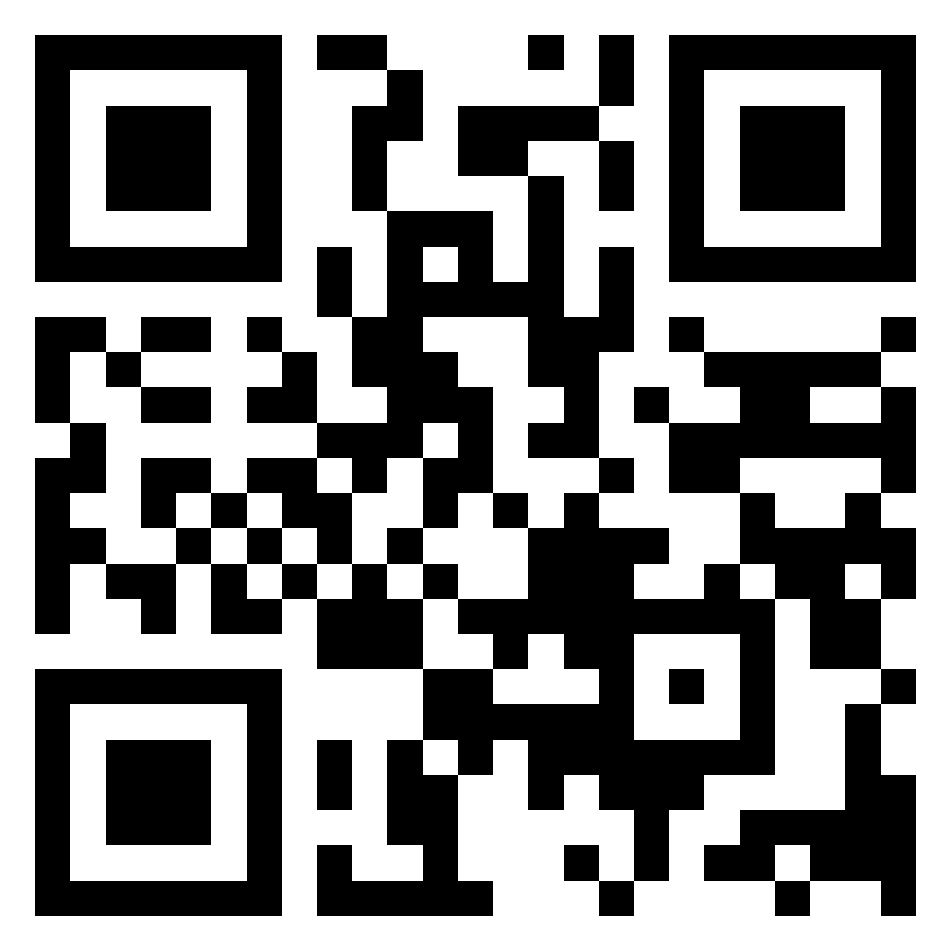
Thank You

